Slide 1

Book Recommender System Using Neural Networks Prepared BY: Mulualem Asmare
Picture source:Agrawal, R. (2022, July 26). How to build a book recommendation system. Analytics Vidhya. https://www.analyticsvidhya.com/blog/2021/06/build-book-recommendation-system-unsupervised-learning-project/

Slide 2
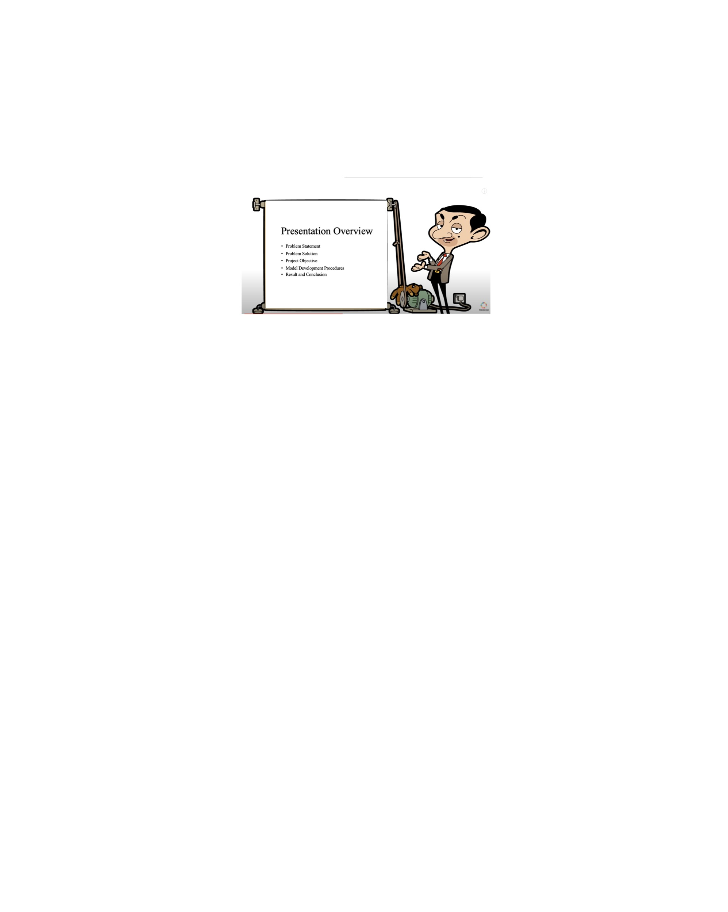
Presentation Overview
Problem Statement
Problem Solution
Project Objective
Model Development Procedures
Result and Conclusion

Slide 3
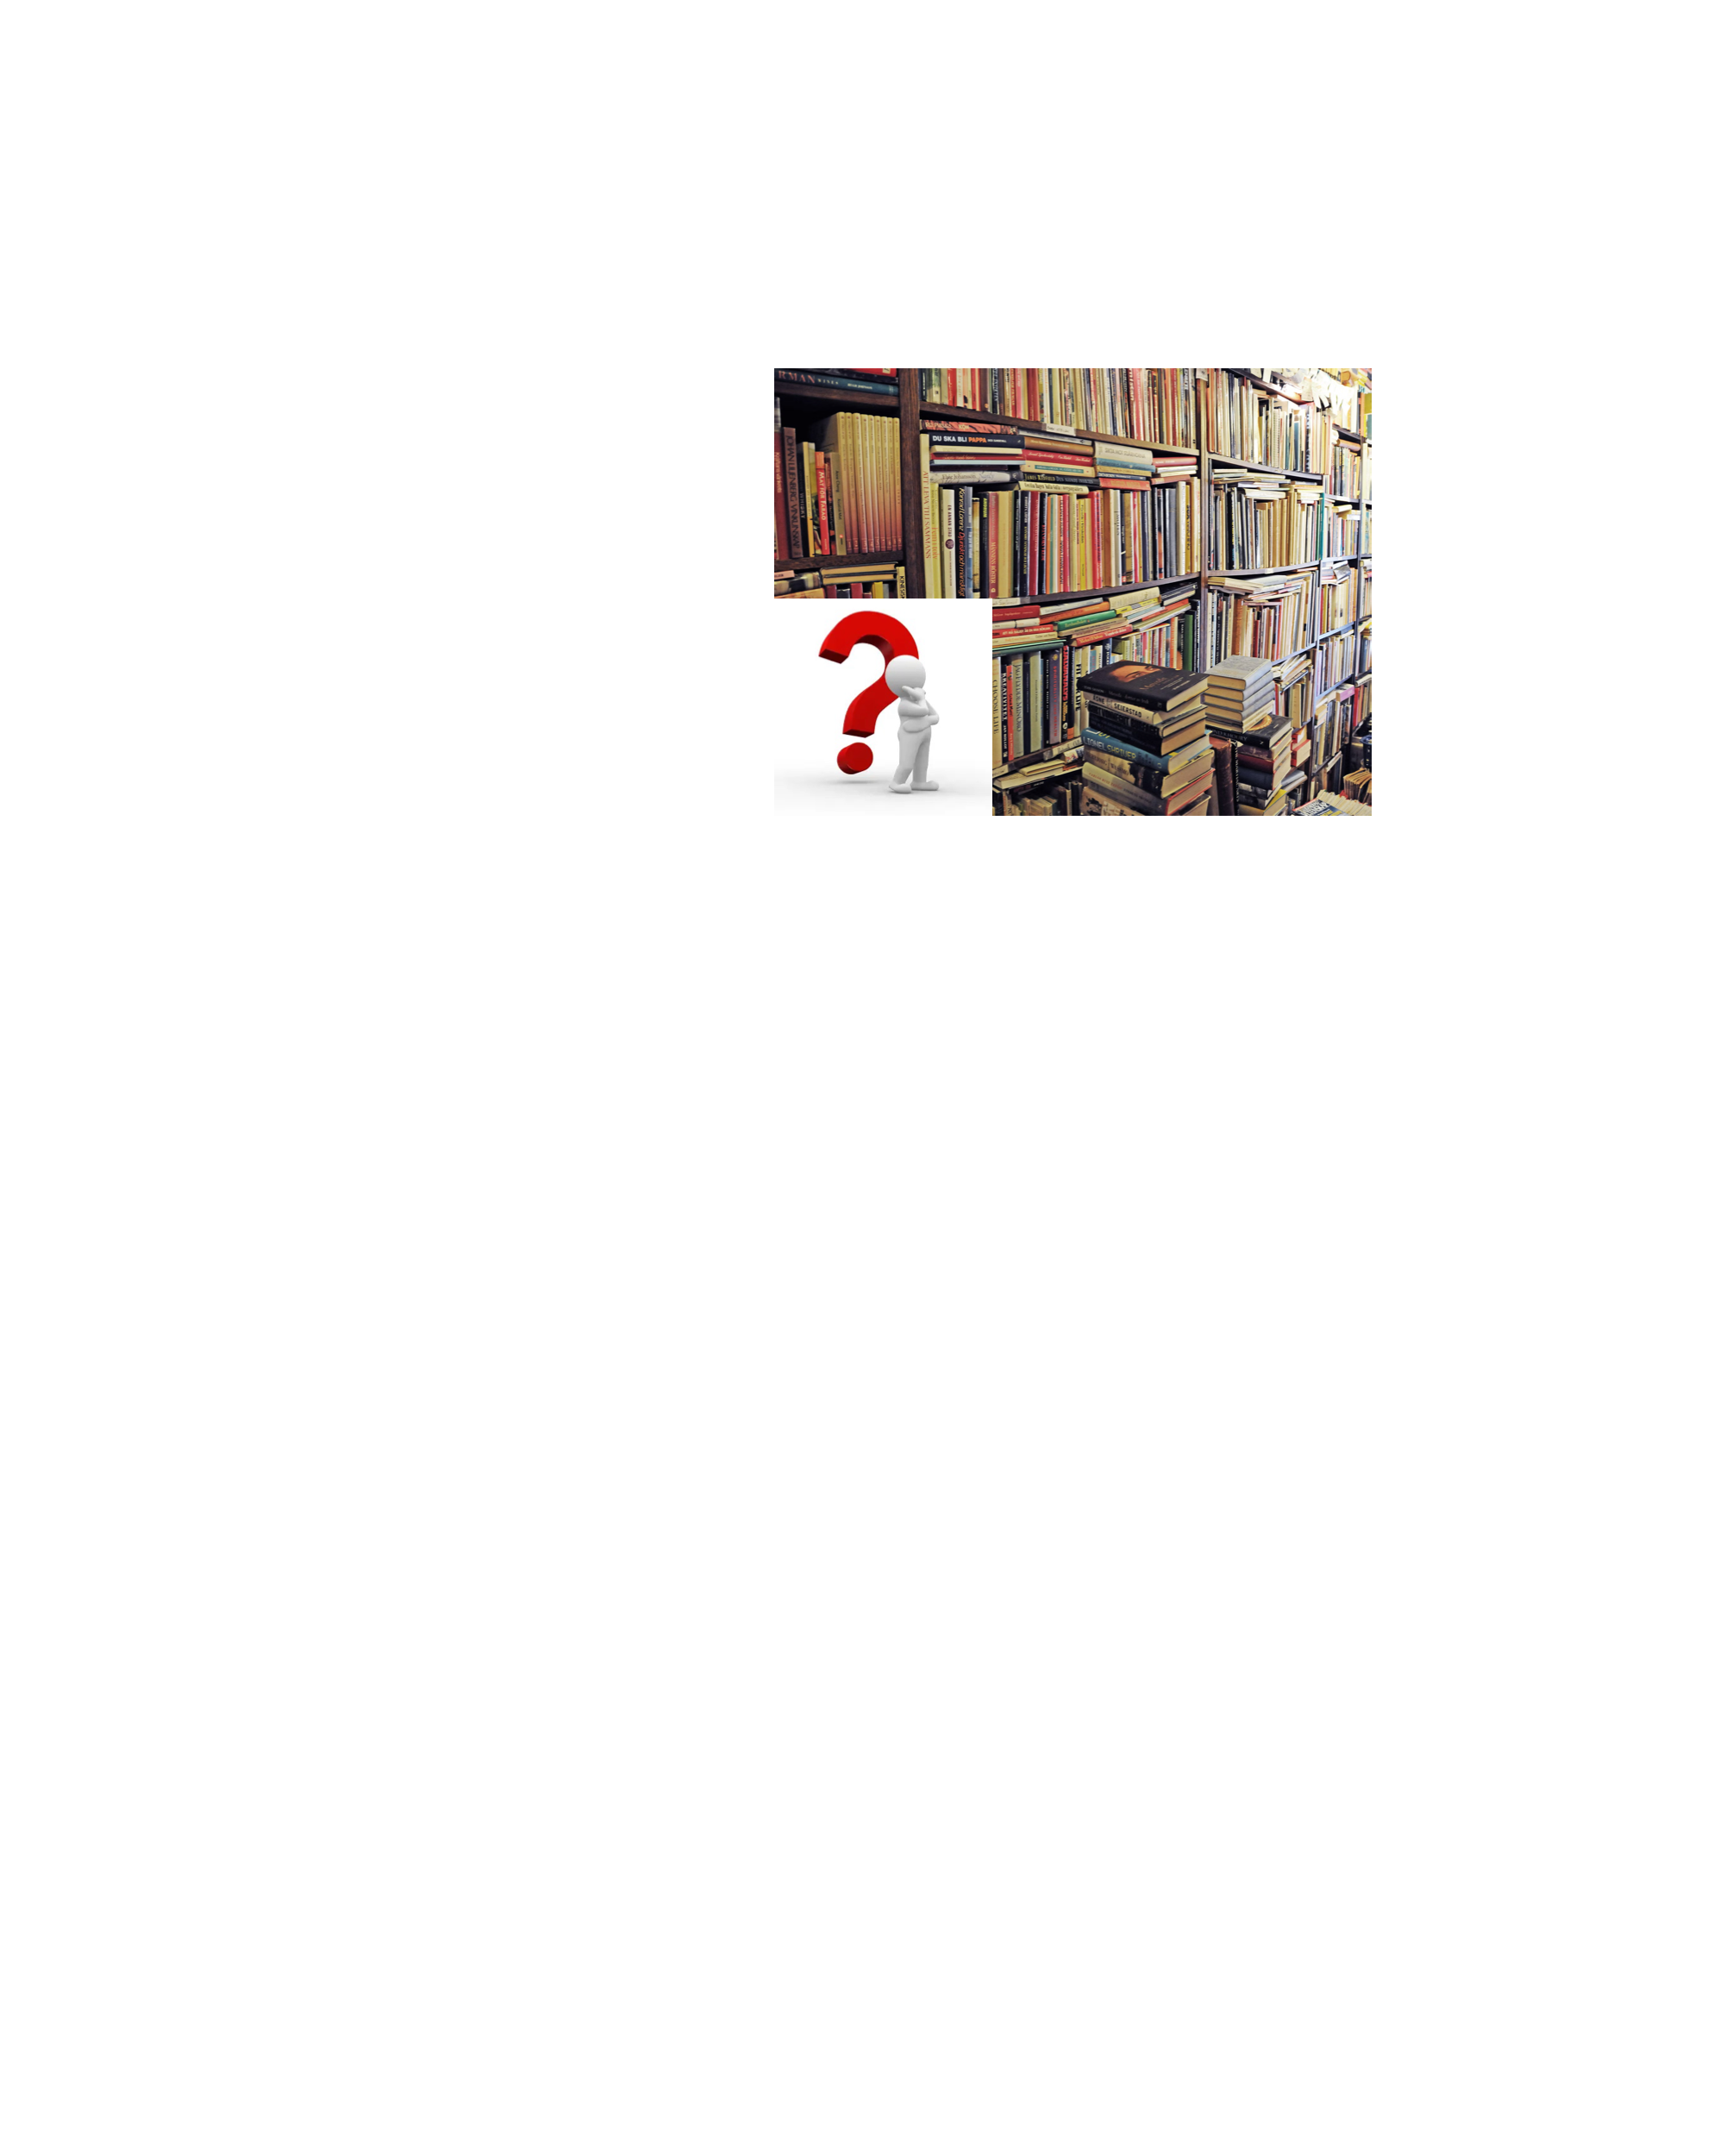
Problem Statement
Companies lacking personalized recommender systems experience:
Poor user experiences
Increased user effort
Lower engagement
Declining revenue
Resource misallocation

Slide 4

Problem Solution
Develop and implement a recommendation system.
Recommendation systems will enable :
Enhance user experience
Facilitate better decision-making
Increase engagement and boost revenue
Amazon's recommender system: 29% sales boost by Q2 2012.
Recommender system market to reach $15.3B by 2026.

Slide 5
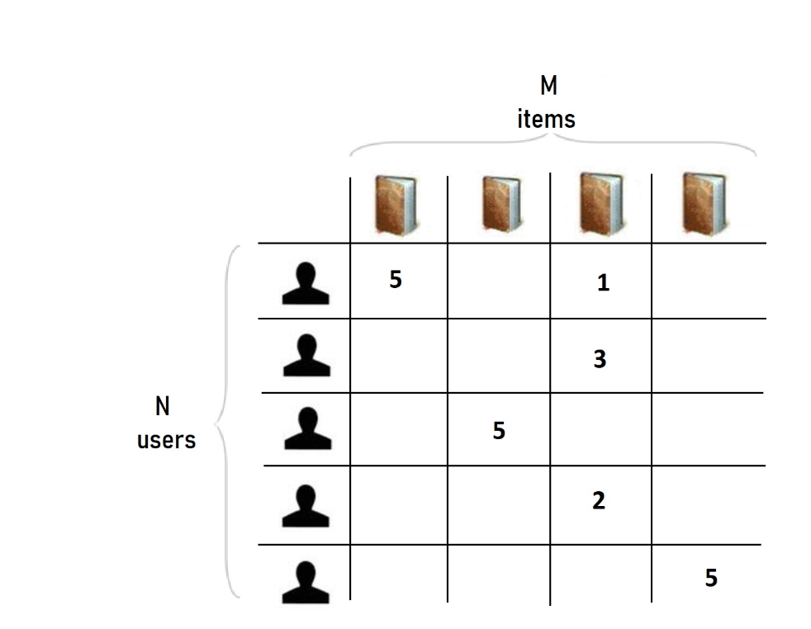
Project Objective
Develop a neural collaborative filtering recommendation system.
Train it with preprocessed data.
Predict ratings for unread books.
Select the best-performing model.
Recommend top-rated books to each user.

Slide 6
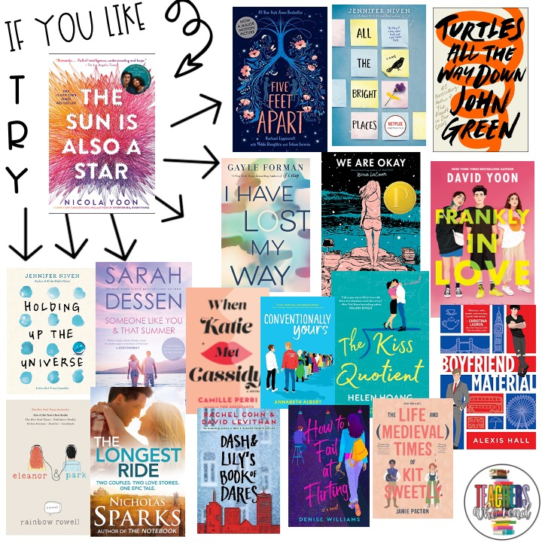
Why do this project ?
Enhance user experience through personalized book recommendations.
Increase user engagement.
Improve productivity and efficiency.
Boost revenue.
Enhance decision-making capabilities.

Slide 7
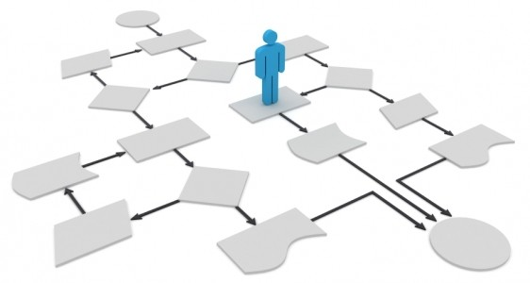
Model Development Procedures
Data Collection & Exploration
Data Preparation & Unification
Unified Data Exploration
Unified Data Preprocessing
Model Development
Evaluation & Hyperparameter Tuning
Recommendation Generation

Slide 8
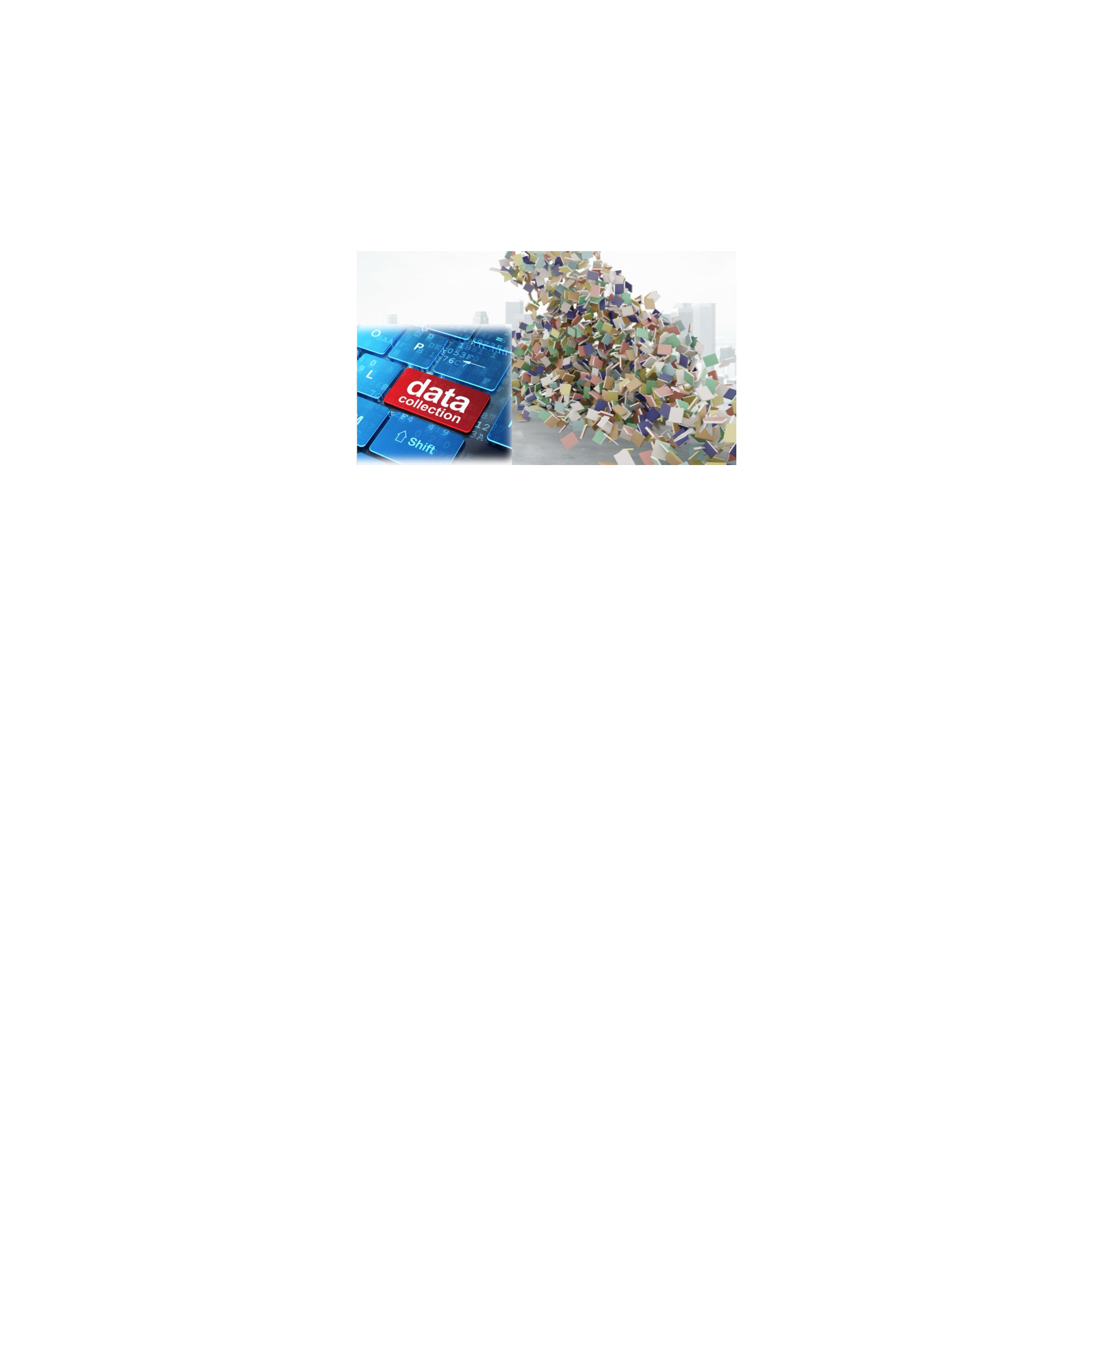
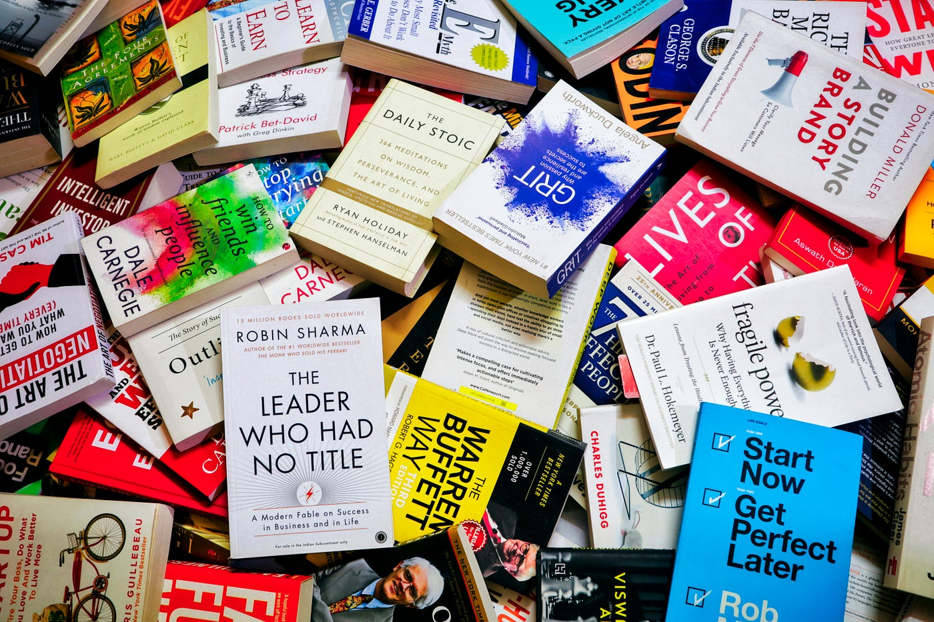
Data Collection and Data Exploration
Utilized three diverse data sources.
Included books from Goodreads and Amazon.
Each source contributed 2 datasets.
Merged datasets using a common key.
Merged datasets have varying column names.
One merged dataset has a different rating scale.

Slide 9


Data Preparation and Unification
Using Codes :
Standardized column names.
Standardized rating scale to 1-5.
Unified datasets along rows.
Selected user ID, book ID, ratings.
Selected title feature for readability.

Slide 10
Unified Data Exploration and Preparation
Unified data: 4 features, 9M rows.
Reduced to 400K rows for efficiency.
Dropped missing values.
Removed duplicates.
Normalized rating scale to 0-1.
Transformed book and user IDs to numerical values.

Slide 11
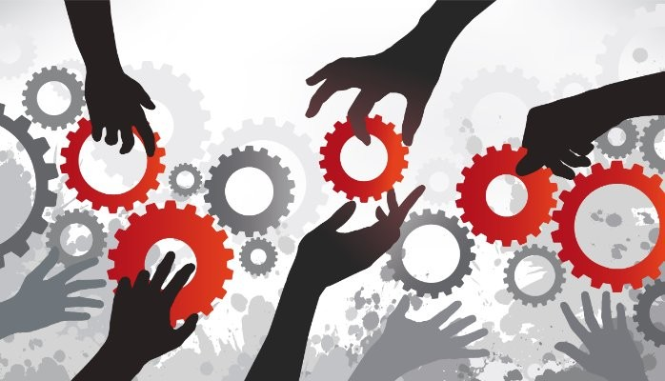
Model Development
Developed three models with feedback and tuning.
Progressed from simple to deep.
Objective: Find the best model.
Increased complexity with layers and tuning.
Selected top model for recommendation.

Slide 12

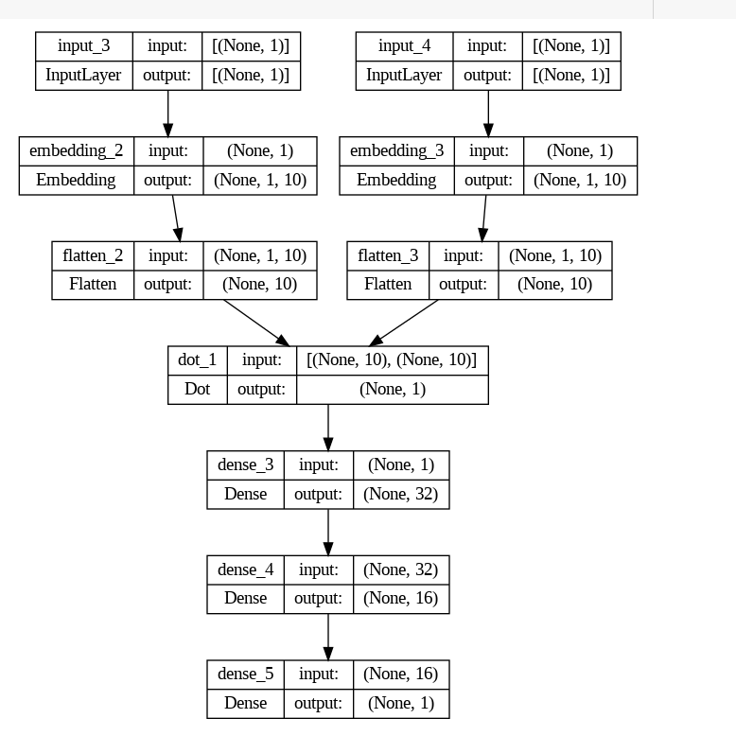
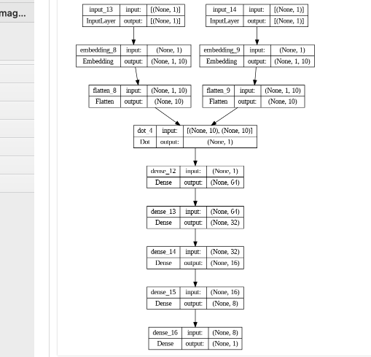
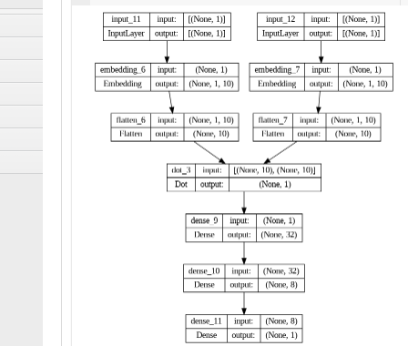
Model Architectures
Input layers for users and books.
Learns characteristics at the embedding layer.
Finds similarities between users and books.
Flattens characteristics for efficiency.
Uses dot product for comparison.
Sends to dense layers for more insights.
Predicts user-book ratings.

Slide 13
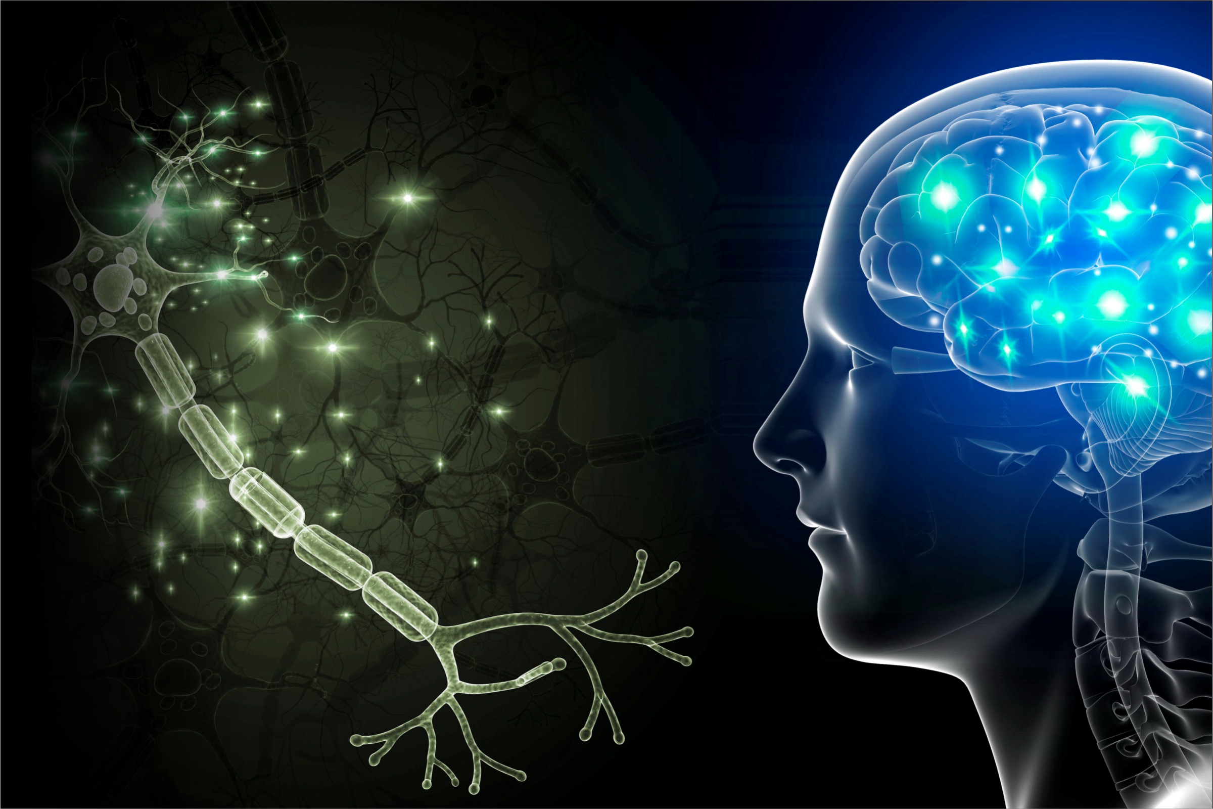
Model Selection
Tweaked the models based on feedback.
Selected the model with the lowest MAE.
MAE measures error between predicted and actual rating.
Aimed to minimize error for accurate predictions.

Slide 14
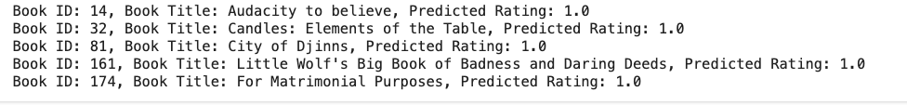
Book Recommendation
User ID 118683 was randomly selected.
Our best model was used for book recommendations.
Recommended books are based on the user's preferences and similarity to their tastes.
Some recommended books include:
Audacity to Believe
Candles: Elements of the Table and City of Djinns

Slide 15
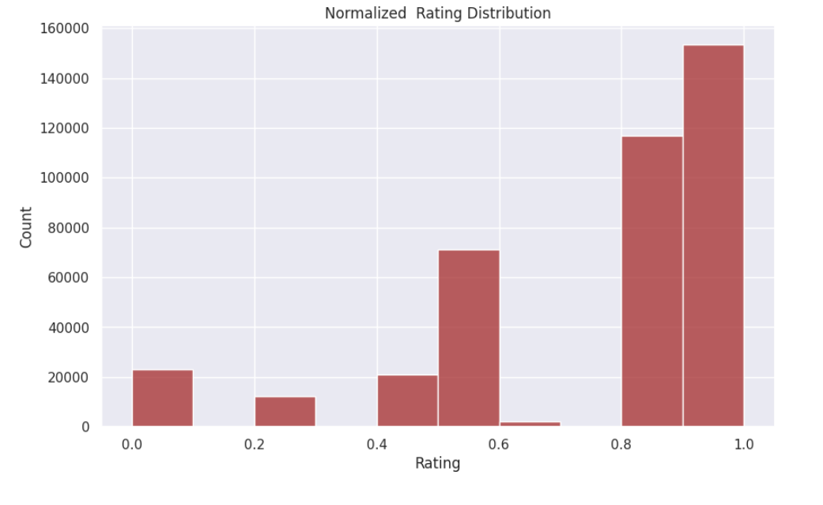
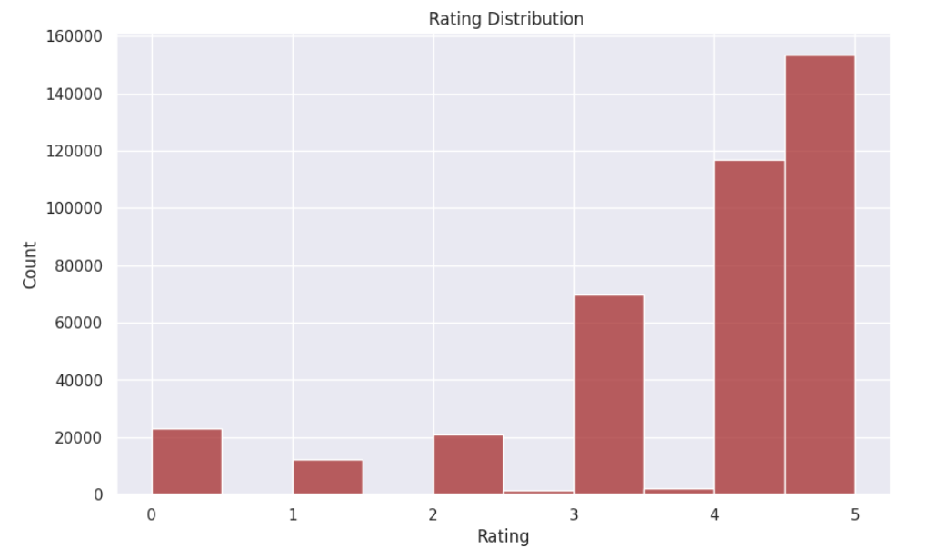
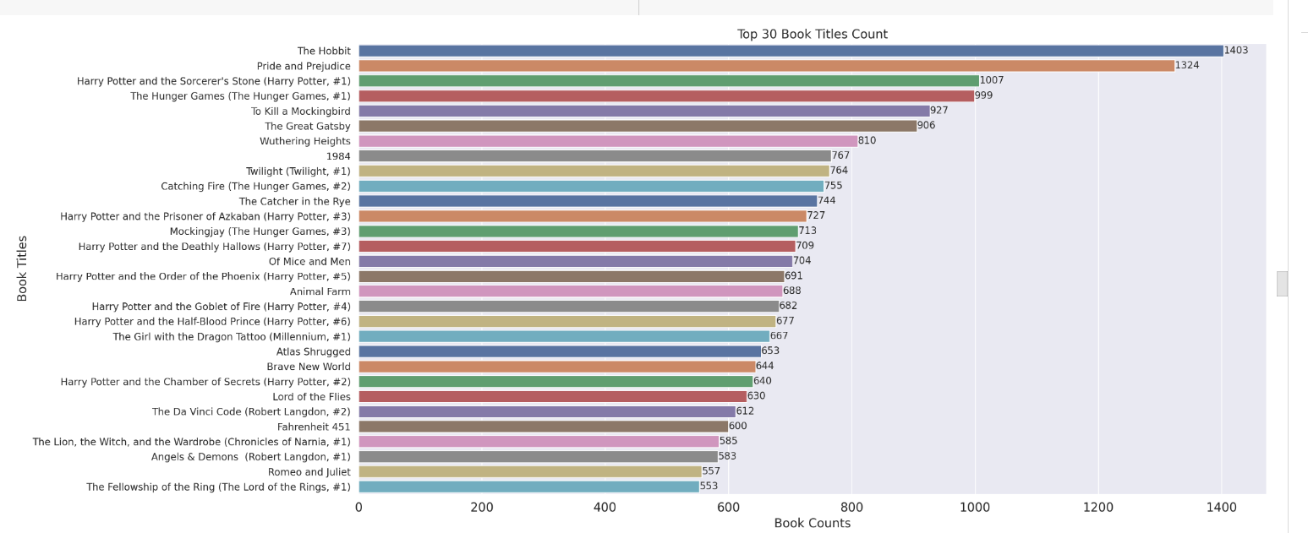
Exploratory Data Analysis Results

Slide 16





Conclusion
Develop neural network book recommendation system.
Learns user-book relationships to predict ratings.
Uses entry points, embedding layer, and dot products.
Successful recommendations but requires further refinement.
Enhances user experience, engagement, revenue

Slide 17

References
Agrawal, R. (2022, July 26). How to build a book recommendation system. Analytics Vidhya. https://www.analyticsvidhya.com/blog/2021/06/build-book-recommendation-system-unsupervised-learning-project/
Bajpai, A. (2022, April 4). Top books for data science (must-read). Medium. https://medium.com/@anushka.datascoop/top-books-for-data-science-must-read-4b8a97e8c80c
OpenAI. (2024). ChatGPT (3.5) [Large language model]. https:/chat.openai.com
Recommendation Systems and machine learning. Recommendation Systems and Machine Learning. (n.d.). https://www.itransition.com/machine-learning/recommendation-systems
Samchak18. (n.d.). Samchak18/Book-Recommendation-System: GitHub. https://github.com/samchak18/Book-Recommendation-System
Scherer, F. (2018, March 9). The 8 benefits of having good procedures. LinkedIn. https://www.linkedin.com/pulse/8-benefits-having-good-procedures-fr%C3%A9d%C3%A9ric-scherer/
Why the need for too much data is a fatal leadership flaw | inc.com. (n.d.). https://www.inc.com/jim-schleckser/why-need-for-too-much-data-is-a-fatal-leadership-flaw.html

Slide 18


